Slide 1
CPS 510
Virtual Machines and Hypervisors
Jeff Chase
Duke University

Slide 2
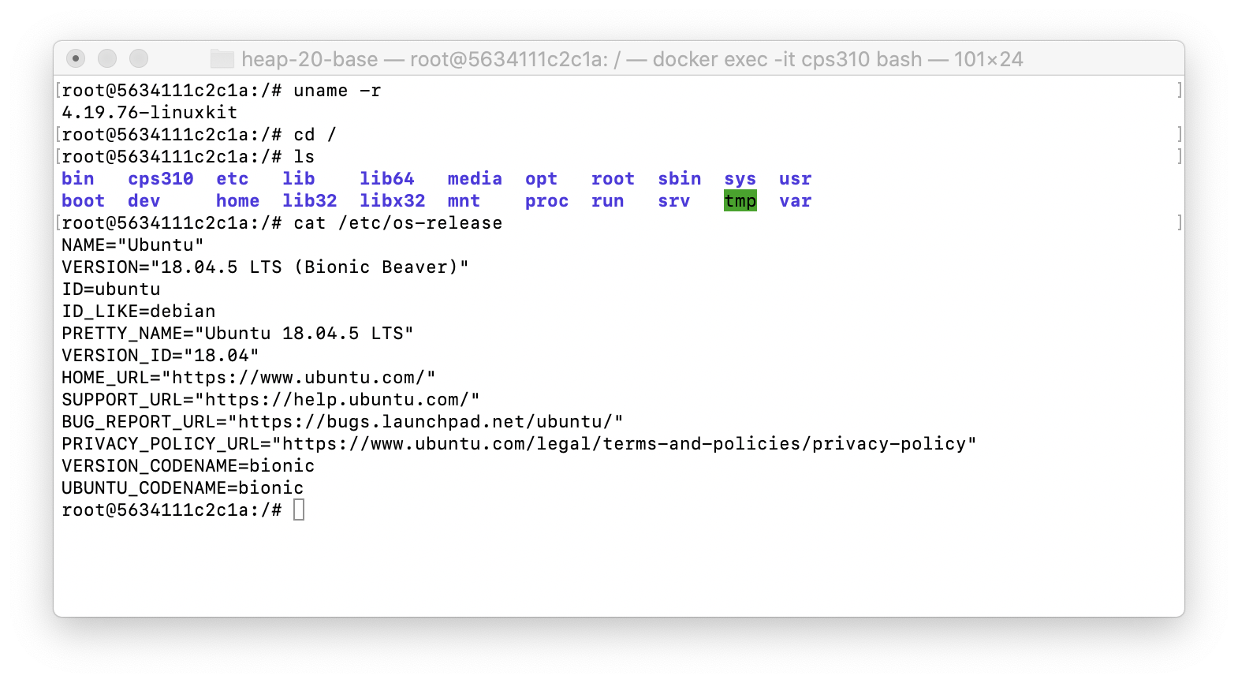
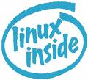
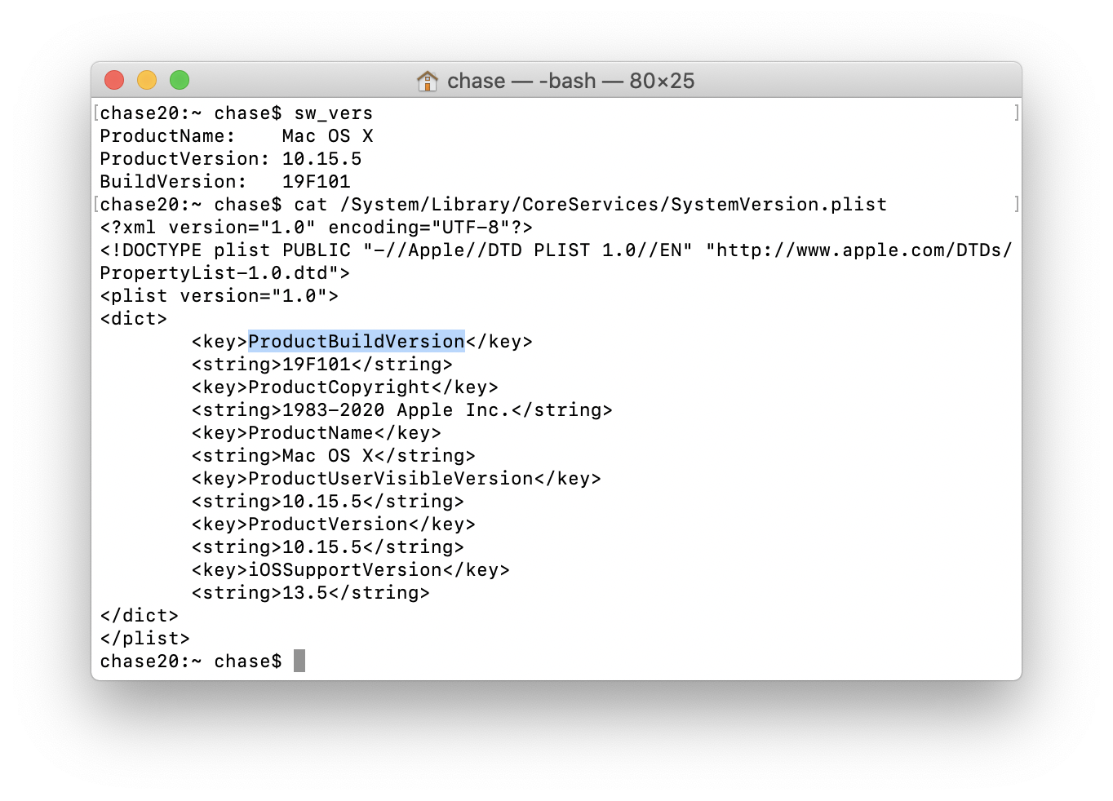
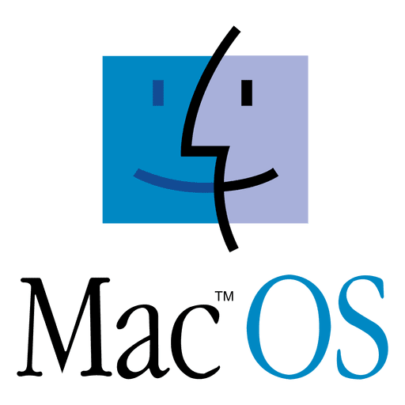

The magic of desktop containers

Slide 3

Containers (e.g., Docker): we get it
Containers on a machine run over a common OS kernel.
Kernel provides foundational abstractions to build them.
Control groups (cgroups)
Namespaces
Filesystem layers
Capabilities
But how can Linux containers run on a MacOS system?
Where’s the kernel?
Graphic from To Docker or Not to Docker: A Security Perspective. Combe, Martin, Di Pietro. IEEE Cloud Computing. 2016.

Slide 4
Native virtual machines (VMs)
Slide a hypervisor within/underneath the host OS kernel.
New OS layer: also called virtual machine monitor (VMM).
Hypervisor implements virtual machines (VMs).
Run multiple guest VM instances on a shared computer.
Each VM is a sandboxed/isolated context for any entire OS.
VM instance “looks the same” to guest OS as a physical machine.
guests
host
hypervisor (VMM)

Slide 5
Three models for virtual servers
“Type 1” VMM:
bare-metal hypervisor
“Type 2” VMM: built into MacOS, Windows, Linux (KVM)
Note: containers may also be layered above VMs, within a guest OS.
You can have it all.
Graphic from To Docker or Not to Docker: A Security Perspective. Combe, Martin, Di Pietro. IEEE Cloud Computing. 2016.

Slide 6
Understanding native VMs
Native VMs are distinct from e.g. Java VM (JVM).
JVM runs within an ordinary process.
Emulates/interprets ISA for an abstract machine.
E.g., Java bytecode is one such ISA.
Java compiler translates to ISA; JVM interprets it.
JVMs support that ISA on every real machine.
So compiled Java applications are “transportable”.
Slow! But it helps that JVMs have an embedded “just in time” (JIT) compiler to the underlying machine ISA.
On native VMs, software is built for the native machine ISA, and runs at full speed on the hardware. But how?

Slide 7
Virtual is real!
The figures give an idea that a VM runs “above” the hypervisor, i.e., the hypervisor emulates the VM.
But it doesn’t! A thread in a process in a VM runs right straight on the metal at full speed.
Until there is a trap, fault, or interrupt! In a VM, some of these force a VM exit to host mode (hypervisor).
Hypervisor is not “between” the VM and the CPU.
Rather, it intercepts certain events and handles them in software.
And it can inject events into a VM.

Slide 8
The p-p-paradigm
monitor / controller
configure
launch/restart
exception notify
machine
Machine runs according to its configuration. If it encounters a condition that requires controller to intervene, it suspends processing and generates an exception for the controller.
Compare: Limited Direct Execution in OSTEP.

Slide 9
“Virtualization” in an OS
Launch programs→processes.
Isolation and access control.
data
data
Allocate memory frames.
Allocate CPU time.
Hide it all from user code.
Allocate I/O resources,
mediate I/O.
What are the architectural foundations that enable all this magic?

Slide 10

OS: architectural foundations
Protected mode bit: user vs. kernel
Maps for virtual memory
VPN→PFN
Control registers for kernel
CR3: current memory map base (a PFN)
PCID: process context ID (for TLB tags)
Current thread and its kernel stack SP
Events transfer control to kernel handler
Trap: syscall instruction
Fault, e.g., page fault
Interrupt, e.g., I/O or clock
Event vectors. Kernel configures event handling.
user
space
Safe control transfer
kernel
code
kernel
space
kernel
data

Slide 11
VM: architectural foundations
Protected modes. Double up! host and guest
Maps. Double up! Extended Page Tables (EPT)
gVPN→gPFN; gPFN→hPFN
Control registers. Double up!
CR3: map base for host and guest
“Virtual processor” VPID and PCID
Event vectors. Double up! Define event handlers for host kernel (hypervisor) and guest.
Events. Configure for host vs. guest
Trap: add hypercalls for “paravirtualized” OS
Fault: configure interceptions per-VM
Interrupt: delivery in host vs. guest
guest
user
kernel
gCR3
PCID
host kernel
hCR3
VPID

Slide 12
CPU protection modes (IA64-VMX)
Guest
(VMX Non-Root)
Host
(VMX Root)
User process that is not within any guest VM. E.g., vanilla, or operator tools, device emulation.
User
(Ring 3)
User process in a VM
“It’s all the same.”
Guest OS kernel:
Controls a VM, might not distinguish it from a physical machine.
Hypervisor
(only one)
Kernel
(Ring 0)
Double up! Now we have two mode bits→ four combinations.
Many guests (each with VMCS), with many processes (each with PCID).

Slide 13
VMX mode switches: simplified
Boot here

Slide 14
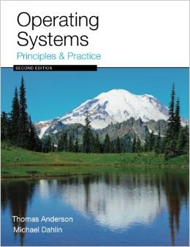
Virtual Machines and Virtual Memory
gVA→gPA
gPA→hPA
Intel VT-x: Extended Page Tables (EPT)

Slide 15
EPT: simplified view
AMD calls the extra VM-enabling structure a Nested Page Table (NPT).
But it’s the same thing.
Graphic from Teaching Virtualization by Building a Hypervisor. By Abhinand Palicherla, Tao Zhang, and Donald E. Porter. SIGCSE 2015.

Slide 16
VMX mode switches
guest kernel
guest user
Intel’s Virtual Machine Extensions (VMX) introduce new VMX instructions and a Virtual Machine Control Structure (VMCS) to configure mode switches per-VM.
Graphic from Intel SGX Explained (Costan and Devadas, IACR Cryptology, 2016)

Slide 17
What causes a VM exit?
Page fault on gPA (VM RAM)
VMCALL trap from guest-kernel mode (hypercall)
VMCS-configured interceptions
E.g., emulated instructions
Configured interrupts
E.g., clock
Non-virtualizable devices
From Intel SGX Explained (Costan and Devadas, IACR Cryptology, 2016)

Slide 18
Extended Page Tables: EPT (VMX)
gVA→gPA
gPA→hPA
gPA→hPA mappings typically use 2MB superpages to save one walk level.
Graphic from Intel SGX Explained (Costan and Devadas, IACR Cryptology, 2016)

Slide 19
TLB miss → “2D page walk”
Guest page maps are populated with gPFNs.
Any such gPFN must translate to an hPFN to access memory.
Thus a 4-level g-map fetch requires four rounds of gPFN→hPFN translation.
…through 4-level h-map.
→ at worst 20-24 map references on a TLB miss.
Now CPUs reduce cost with new TLB-like caches, tagged by VPID and PCID.
Graphic from Intel SGX Explained (Costan and Devadas, IACR Cryptology, 2016)

Slide 20
Type 2 example: HOSS
In a type 2, a VM “looks like a process/VAS” to the host kernel (hypervisor).
HOSS extends JOS →VMs.
Projects?
Hypervisor talks to a user process (qemu) to emulate PC-like devices.
Linux KVM uses this approach as well.
Teaching Virtualization by Building a Hypervisor. By Abhinand Palicherla, Tao Zhang, and Donald E. Porter. SIGCSE 2015.

Slide 21
Reflections on VMs
Why are we doing this? At what cost?
Custom environments, fault containment/security, virtual infrastructure services with performance isolation.
OS refactoring? Smaller TCB? Microkernels done right?
Focus on resources, separate control and data paths, avoid “liability inversion” (e.g.,Mach pagers).
Run apps in guest mode and expose hardware control: Dune 2012, high-speed I/O with Arrakis 2014.
How long before we got VMs right? Software approaches struggled without good hardware support.
Are Virtual Machine Monitors Microkernels Done Right?
Steven Hand, Andrew Warfield, + Fraser, Kotsovinos, Magenheimer, HotOS 2005.

Slide 22
IA Protection Rings (CPL)
Actually, IA has four protection levels, not two (kernel/user).
IA/X86 rings (CPL)
Ring 0 – “Kernel mode” (most privileged)
Ring 3 – “User mode”
Ring 1 & 2 – Other
Linux only uses 0 and 3.
“Kernel vs. user mode”
Pre-VT VMMs modified to lift the guest OS kernel to Ring 1: reserve Ring 0 for hypervisor.
CPU Privilege Level (CPL)
[Fischbach]

Slide 23
Why aren’t (IA) rings good enough?
VM
CPL 3
guest kernel
CPL 1
hypervisor
CPL 0
???

Slide 24
A short list of pre-VT problems
Early IA hypervisors (VMware, Xen) had to emulate various machine behaviors and generally bend over backwards.
IA32 page protection does not distinguish CPL 0-2.
Segment-grained memory protection only.
Ring aliasing: some IA instructions expose CPL to guest!
Or fail silently…
Syscalls don’t work properly and require emulation.
IA sysenter always transitions to CPL 0. (D’oh!)
IA sysexit faults if the core is not in CPL 0.
Interrupts don’t work properly and require emulation.
Interrupt disable/enable reserved to CPL0.

Slide 25
Early approaches to IA VMMs
To implement virtualization on IA in the pre-VT days, you have to modify the guest OS kernel.
To run a proprietary OS (i.e., Windows) you had to do it on the sly.
VMware: software binary translation (code morphing—patented)
If it’s an open-source OS (e.g., Linux) you can do it out in the open.
Xen: paravirtualization
Basically just a change to the HAL/PAL: a VM is just another machine type to support (<2% of the OS code).
Of course you can always do full emulation! (pre-KVM qemu)
All of this is washed away by VT.
(Of course, hardware-based VMs were also done correctly on IBM machines a lonnnng time ago.)

Slide 26
Notes on implementing VMs today
CPUs after 2007 support protected mode(s) for hypervisors (E.g., Intel VTx).
When the hypervisor initializes a VM context (e.g., VMCS), it selects some set of event types to intercept, and registers handlers for them.
Configured interceptions transfer control to a registered hypervisor handler routine. For example, a guest OS kernel accessing device registers may cause the physical machine to invoke the hypervisor to intervene.
Architecture adds another level of indirection in the MMU page mappings (Intel’s Extended Page Tables). A hypervisor uses it to specify and restrict what parts of physical memory are visible to each guest VM.
A guest can map to or address a physical memory frame or command device DMA I/O to/from a physical frame if and only if the hypervisor permits it.
If any guest VM tries to do anything weird, then the hypervisor regains control and can see or do anything to any part of the physical or virtual machine state before (optionally) restarting the guest VM.

Slide 27
According to Dune
2.1 The Intel VT-x Extension
In order to improve virtualization performance and simplify VMM implementation, Intel has developed VT-x [37], a virtualization extension to the x86 ISA. AMD also provides a similar extension with a different hardware interface called SVM [3].
The simplest method of adapting hardware to support virtualization is to introduce a mechanism for trapping each instruction that accesses privileged state so that emulation can be performed by a VMM. VT-x embraces a more sophisticated approach, inspired by IBM’s interpretive execution architecture [31], where as many instructions as possible, including most that access privileged state, are executed directly in hardware without any intervention from the VMM. …The motivation for this approach is to increase performance, as traps can be a significant source of overhead.
VT-x adopts a design where the CPU is split into two operating modes: VMX root and VMX non-root mode. VMX root mode is generally used to run the VMM and does not change CPU behavior, except to enable access to new instructions for managing VT-x. VMX non-root mode, on the other hand, restricts CPU behavior and is intended for running virtualized guest OSes.
Transitions between VMX modes are managed by hardware. When the VMM executes the VMLAUNCH or VMRESUME instruction, hardware performs a VM entry; placing the CPU in VMX non-root mode and executing the guest. Then, when action is required from the VMM, hardware performs a VM exit, placing the CPU back in VMX root mode and jumping to a VMM entry point. Hardware automatically saves and restores most architectural state during both types of transitions. This is accomplished by using buffers in a memory resident data structure called the VM control structure (VMCS).
In addition to storing architectural state, the VMCS contains a myriad of configuration parameters that allow the VMM to control execution and specify which type of events should generate VM exits. This gives the VMM considerable flexibility in determining which hardware is exposed to the guest. For example, a VMM could configure the VMCS so that the HLT instruction causes a VM exit or it could allow the guest to halt the CPU. However, some hardware interfaces, such as the interrupt descriptor table (IDT) and privilege modes, are exposed implicitly in VMX non-root mode and never generate VM exits when accessed. Moreover, a guest can manually request a VM exit by using the VMCALL instruction.
Virtual memory is perhaps the most difficult hardware feature for a VMM to expose safely. A straw man solution would be to configure the VMCS so that the guest has access to the page table root register, %CR3. However, this would place complete trust in the guest because it would be possible for it to configure the page table to access any physical memory address, including memory that belongs to the VMM. Fortunately, VT-x includes a dedicated hardware mechanism, called the extended page table (EPT), that can enforce memory isolation on guests with direct access to virtual memory. It works by applying a second, underlying, layer of address translation that can only be configured by the VMM. AMD’s SVM includes a similar mechanism to the EPT, referred to as a nested page table (NPT).
From Dune: Safe User-level Access to Privileged CPU Features, Belay et al., (Stanford), OSDI, October, 2012

